Slide 1
COURSERA CAPSTONE PROJECT REPORT
BATTLE OF NEIGHBORHOODS- FINDING A LOCATION TO OPEN AN INDIAN RESTAURANT IN AUSTIN,TX

Slide 2
Business Problem
The objective of this capstone project is to analyze and select the best location in the city of Austin, Texas to open a new Indian restaurant. Using Data Science methodology and instruments such as Data Analysis and Visualization, this project aims to provide solutions to answer the business question: Where can I open an Indian restaurant in Austin, Texas.

Slide 3
Data
To solve the problem, we will need the following data:
Austin data containing the zip codes.
Latitudes and Longitudes of those neighborhoods to plot the map and get the venues.
Venue data particularly the data related to restaurants.
Sources of data:
Gathered data from the website named Zip Atlas. http://zipatlas.com/us/tx/austin/zip-code-comparison/percentage-indian-population.htm
Foursquare API for venue data

Slide 4
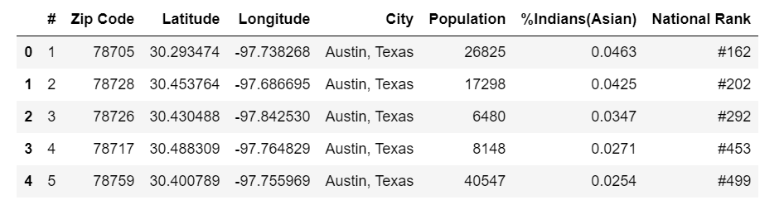
Data in panda dataframe

Slide 5
Methodology
Collect data from http://zipatlas.com/us/tx/austin/zip-code-comparison/percentage-indian-population.htm Clean and process the data into the dataframe.
Using Foursquare API, find top 100 venues within the radius of 1500 meters for the zip codes.
Use K-means cluster analysis to cluster the zip codes and examine the data.
Compare the cluster analysis results with demographic data which contains the percentage of Indian population.

Slide 6
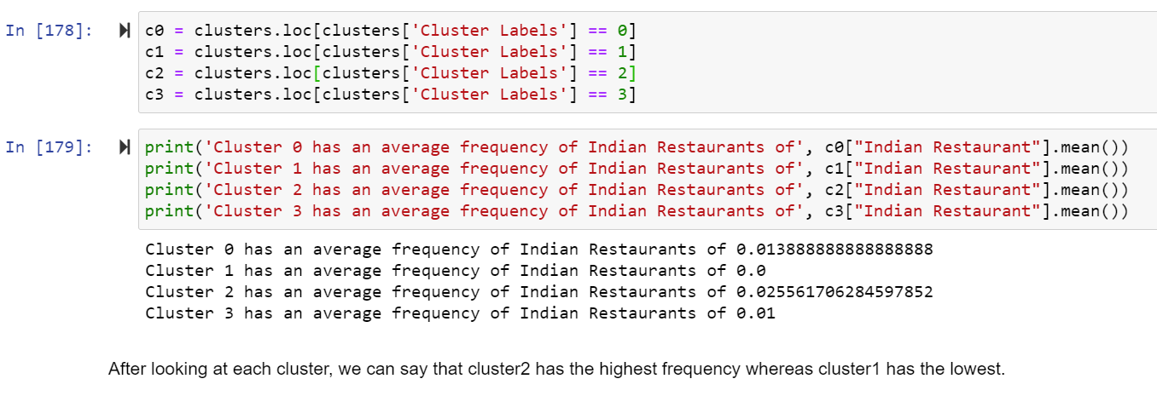
Results

Slide 7
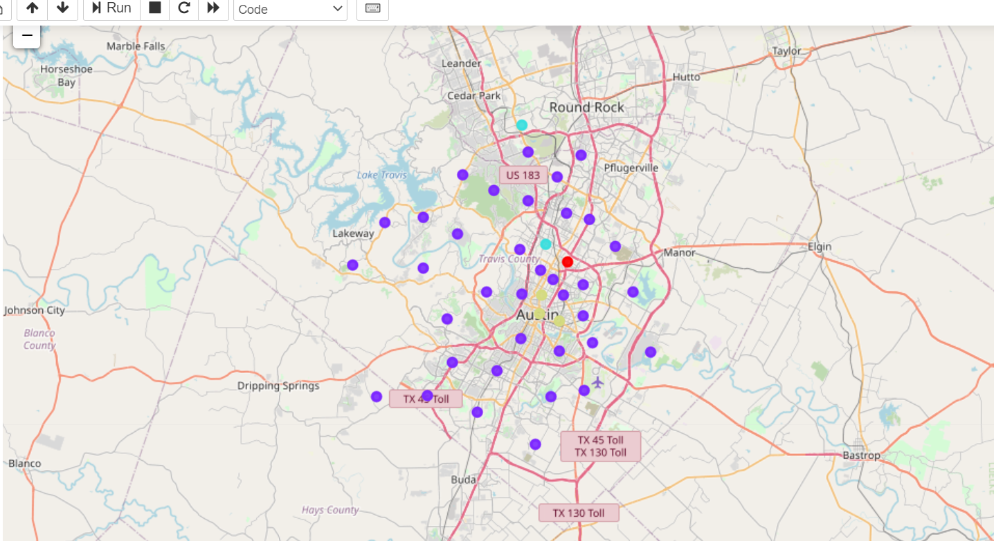
Results
Cluster0-Red, Cluster1-Purple, Cluster2-Light Green, Cluster3-Blue. From the map, we can observe that most of the Indian Restaurants are located in Central part of Austin. Cluster0 and Cluster3 are located in the central part of the city whereas Cluster2 which has the highest frequency of Indian restaurants is located towards north of Austin.

Slide 8
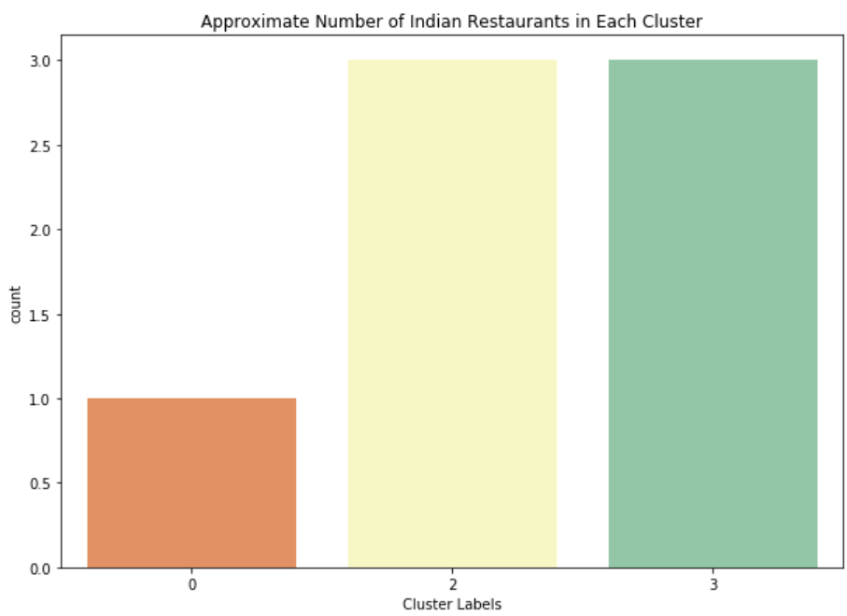
Results

Slide 9
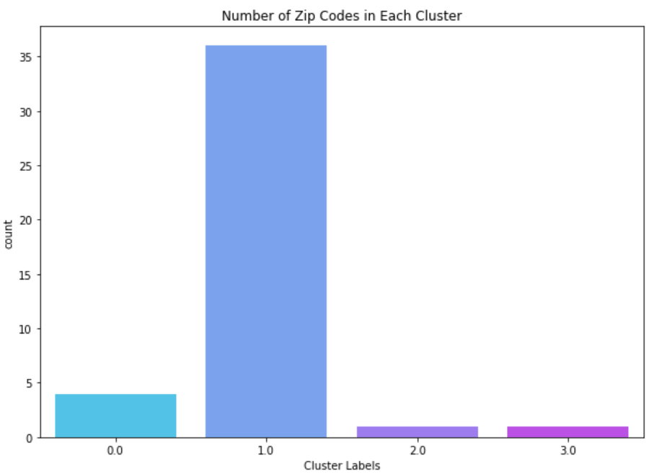
Results

Slide 10
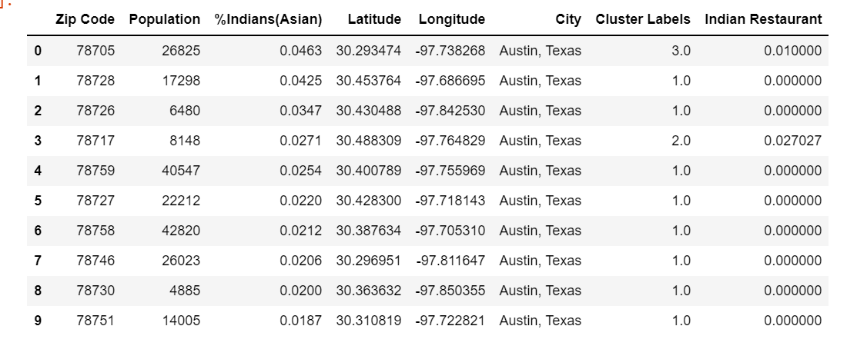
Results

Slide 11
Results and Discussion
Based on our cluster analysis result, we found that cluster2 has highest frequency of Indian restaurants when compared to the rest of the clusters and cluster1 has the lowest. However, we can see that cluster3 has low frequency and high number of Indian restaurants and this maybe because of higher number of zip codes in that cluster. Cluster1 has highest number of zip codes but there are no Indian restaurants. To make a decision on which zip code would be better to open a restaurant, we looked at the demographics of Indian population in those zip codes. When we look at the demographics of top nine zip codes with highest to lowest Indian population, I found that most of the zip codes belong to cluster1. Which means that cluster1 has no Indian restaurants in the areas where the population of Indians are high. The most Indian populated zip code belongs to cluster0. Sometimes the reason for the zip codes having Indian population but no Indian restaurant is because the overall population for those zip codes is low. But there are some zip codes which have high overall population and high Indian population but no restaurants for example zip codes 78759,78758. Therefore, we can take these zip codes into consideration to open an Indian restaurant because they are highly populated as well as they have high Indian population.

Slide 12
Limitations
After discussing the possibility of opening an Indian restaurant we should also note some limitations to this analysis. To start with the coordinates taken from the website may not be accurate. They are only an approximation for the zip codes which are given along with the coordinates. The limit set to the Foursquare API for 100 venues within the radius of 1500 meters is also another limitation which has to be considered. This is because there may be other Indian restaurants which were not included in 100 venues and not returned by Foursquare API. Lastly, the data collected for the demographics may also be just an approximation which may have changed. So, before opening a restaurant it is important to know various other factors which lead to success of the restaurant. Many of those factors include consumers, competitors, neighborhoods. For future analysis, considering the neighborhoods where more Indians reside can also give us an insight on where exactly we can open an Indian restaurant which can lead to more success and profits for the restaurant.

Slide 13
Conclusion
In this project we have gone through the process of identifying the business problem: where to open an Indian restaurant in Austin, Tx. We further collected data from a website which had information on the zip codes and its coordinates and also information on the demographics on Indian population in those zip codes. We then used Foursquare API to collect information on top 100 venues within the radius of 1500 meters in each zip code. We then used cluster analysis to analyze the data which was grouped into 4 clusters in total. From this analysis, we could find the average frequency of Indian restaurants and later used the demographic data to compare the zip codes with high Indian population and average frequency of Indian restaurants. From the results, we concluded that zip codes 78759, 78758 both have high overall population and high Indian population but there were not many Indian restaurants. I would therefore open an Indian restaurant in those zip codes if given a chance based on the cluster analysis results and demographic data which was provided.

